Slide 1
Building a Japanese restaurant in london
Mary mavrokapnidou
23/08/2020

Slide 2
Background
London is a city where international cuisine very highly regarded as a means of entertainment and restaurants are very frequently visited by locals and tourists.
Londoners get more and more interested in sushi and Japanese culture in general, so the option to open a Japanese restaurant can prove to be very successful
….if location is chosen wisely!
In this project, due to our investors’ restrictions, we are focused in the growing area of South East London.

Slide 3
Problem statement
Which neighbour in South East London is the most appropriate to open a Japanese restaurant?
Sub questions of our research:
What are the areas that do not have a Japanese restaurant, so that there is not direct competition?
What are the areas that do have not a lot of restaurants but have some, so that they offer some options for dining and attract customers?
What are the areas where tourists usually stay?

Slide 4
Data
Data request
Areas in South-East London (based on postcode)
Areas with Japanese restaurants among their most visited places
Areas where there are either one or two restaurant categories (no more, no less) among their most visited places
Areas that have a hotel
Data sources
Wikipedia, to identify London’s municipalities and the first digits of their postcode
The library Geopy, function Nominatim, that will provide the latitude and longitude of a central point in each municipality
The number of restaurants and their type and location in every neighbourhood will be obtained using Foursquare API

Slide 5
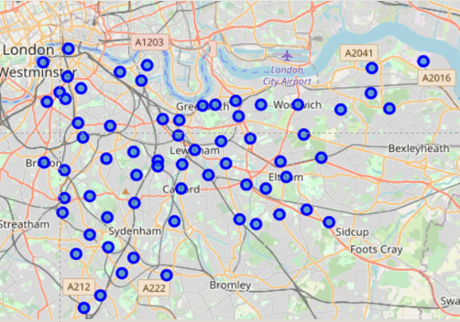
Methodology
We identified the neighbourhoods of South East London and trace their venues
We count their comments on Foursquare and create a rank with the top 10 most popular venue categories per area
We identify the characteristics of the neighbourhoods where Japanese restaurants are high in ranking
We classify the neighbourhoods without Japanese restaurants and propose those with the characteristics found above as best areas for investment

Slide 6
The neighborhoods where Japanese food is most popular are Deptford, new cross and westcombe
We identified the neighbourhoods of South East London
Location | 1st Most Common Venue | 2nd Most Common Venue | 3rd Most Common Venue | 4th Most Common Venue | 5th Most Common Venue | 6th Most Common Venue | 7th Most Common Venue | 8th Most Common Venue | 9th Most Common Venue | 10th Most Common Venue
Catford, London | Supermarket | Grocery Store | Coffee Shop | Italian Restaurant | Train Station | Platform | Greek Restaurant | Theater | Shopping Mall | Sandwich Place
Deptford, London | Coffee Shop | Pub | Gym / Fitness Center | Hotel | Bar | Grocery Store | Vietnamese Restaurant | Cocktail Bar | Athletics & Sports | Japanese_Restaurant
East Dulwich, London | Café | Pub | Grocery Store | Indian Restaurant | Coffee Shop | Burger Joint | Ice Cream Shop | Gastropub | Indie Movie Theater | Bus Stop
Greenwich, London | Pub | Boat or Ferry | Burger Joint | History Museum | Pizza Place | Garden | Art Gallery | Market | Grocery Store | Pier
Lambeth, London | Coffee Shop | Hotel | Bar | Café | Sandwich Place | Korean Restaurant | Beer Bar | Movie Theater | Event Space | Bakery
Maze Hill, London | Grocery Store | Pub | Indian Restaurant | Fried Chicken Joint | English Restaurant | Scenic Lookout | Mediterranean Restaurant | South Indian Restaurant | Café | Recreation Center
New Cross, London | Coffee Shop | Café | Grocery Store | Pub | Gastropub | Cocktail Bar | Chinese Restaurant | Sandwich Place | Japanese_Restaurant | Lebanese Restaurant
Westcombe Park, London | Fried Chicken Joint | Bus Stop | Doner Restaurant | Café | Train Station | Pub | Japanese_Restaurant | Park | Electronics Store | Eastern European Restaurant

Slide 7
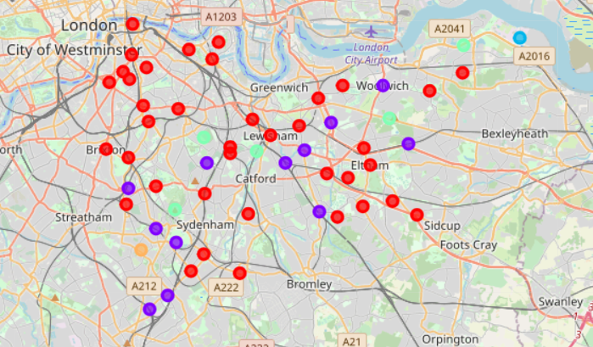
We classify the neighbourhoods in clusters using kmeans method
Looking at the clusters formulated, we observe that the characteristics that favor the success of a Japanese restaurant exist mainly in clusters 1 & 2
hotel existence
one/two popular restaurant categories
pubs, bars and coffee places nearby
As a result, we focus our attention in these clusters

Slide 8
We classify the neighbourhoods in clusters using the kmeans method
Looking at the clusters formulated, we observe that the characteristics that favor the success of a Japanese restaurant exist mainly in clusters 1 & 2
hotel existence
one/two popular restaurant categories
pubs, bars and coffee places nearby
As a result, we focus our attention in these clusters

Slide 9
We classify the neighbourhoods in clusters using the kmeans method to narrow down the options
We will use the criterion 'Hotel existence' to define if a neighbourhood is good to create a Japanese restaurant. Checking the most common venues, the neighbourhoods with a hotel are:
Bankside
New Eitham
Peckham
Penge
Tulse_Hill
In these areas, the neighbourhoods that have either one or two restaurants (not more, not less) are Peckham and Penge
Location | 1st | 2nd | 3th | 4th | 5th | 6th | 7th | 8th | 9th | 10th
Bankside | Hotel | Gym / Fitness Center | Pub | Italian Restaurant | Coffee Shop | Art Museum | Performing Arts Venue | Portuguese Restaurant | Grocery Store | Spanish Restaurant
New Eltham | Platform | Greek Restaurant | Kebab Restaurant | Auto Garage | Auto Dealership | Bus Stop | Hotel | Grocery Store | Bar | Falafel Restaurant
Peckham | Grocery Store | Italian Restaurant | Pharmacy | Bus Stop | Bar | Supermarket | Pub | Cocktail Bar | Indie Movie Theater | Hotel
Penge | Pizza Place | Pub | Fast Food Restaurant | Supermarket | Garden Center | Grocery Store | Coffee Shop | Hotel | Café | Furniture / Home Store
Tulse Hill | Platform | Coffee Shop | Grocery Store | Portuguese Restaurant | Italian Restaurant | Thai Restaurant | Pub | Indian Restaurant | Train Station | Hotel

Slide 10
Conclusion and recommendations
This information was used to trace the neighbourhoods with Japanese restaurants where it wouldn’t be commercially sensible to build a new one due to direct competition reasons.
By observing the popular venue types of these neighborhoods, we confirmed that a successful Japanese restaurant is usually placed
in relatively touristic regions (ie. where a hotel is located)
in places with medium presence of popular restaurants (either one or two).
These characteristics were used to filter the neighbourhoods without Japanese restaurants and leaded to our recommendation of Peckham and Penge as the best areas for investment.

Slide 11
Thank you!

